Slide 1
GUess
Sahiti Kattamedi, Neha Khan, Jorge Mejia, Jesse Ortiz
Professor Mohamed Aly
12/16/2022

Slide 2

Overview
Abstract
Video demonstration
Code
Test Benches
Meet the team

Slide 3
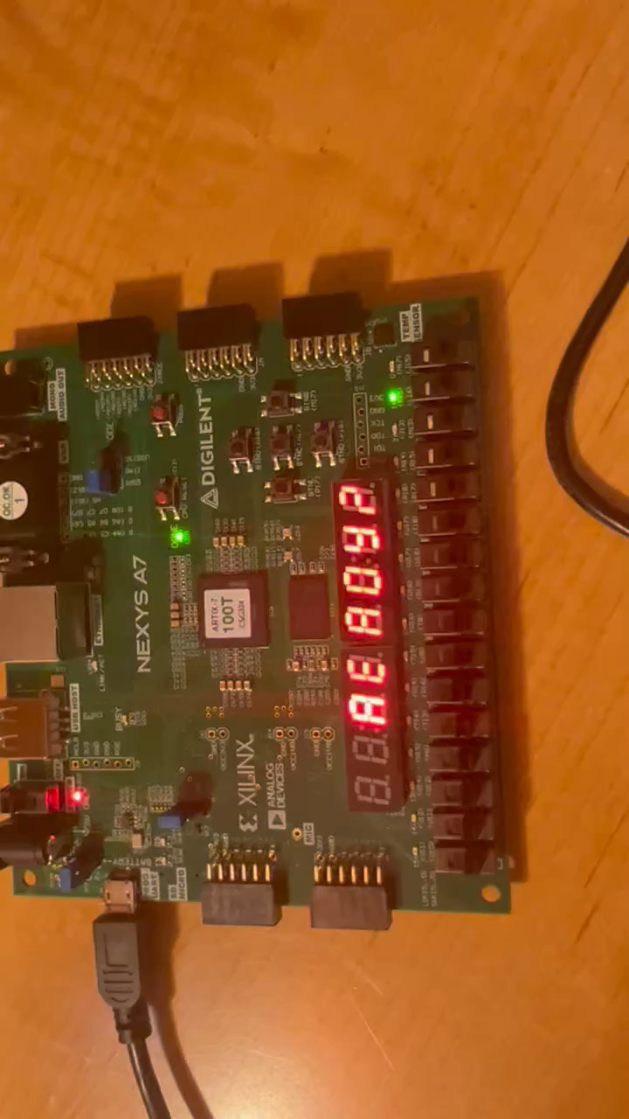
Video Demonstration

Slide 4

Abstract
Our project is a guessing game with the user against the program. When first starting the game, the program will generate a random number from 0 through 15. The UART will give a welcome message on the screen and three LEDs will also be on. The initial three LEDs represent the user’s tries. The user will then use the first four switches to pick their number and then use the button to confirm. The program will compare the number it generated to the number from the user. If wrong, one LED will turn off and with the VGA the screen will be red. If correct, then the screen will be green. In-between the screen will be black. The UART will tell the user when the game is over.

Slide 5
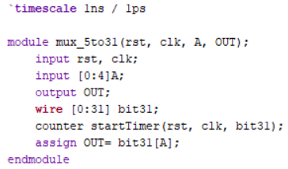
5x31 Multiplexier

Slide 6
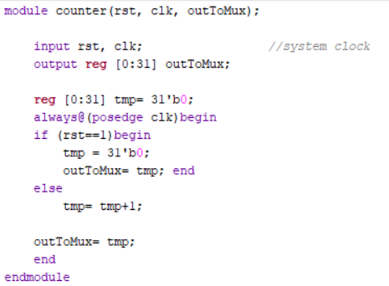
Counter

Slide 7
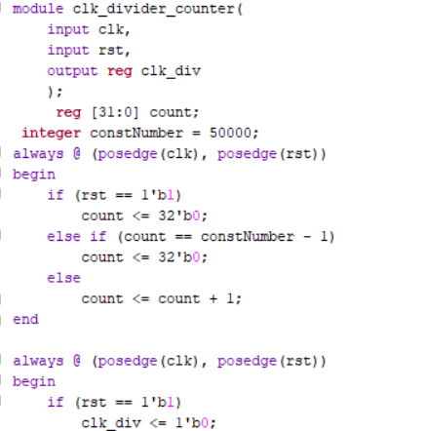
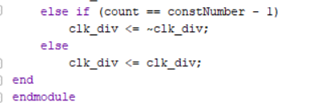
Clock Divider COunter

Slide 8
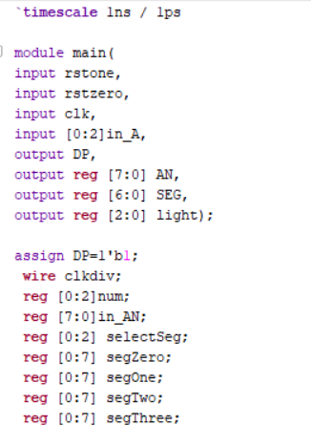
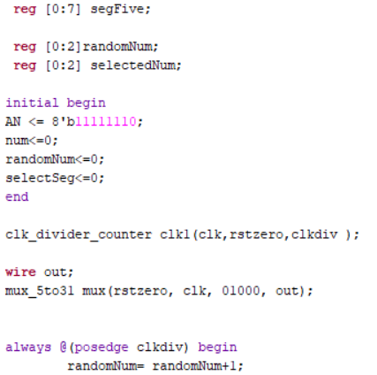
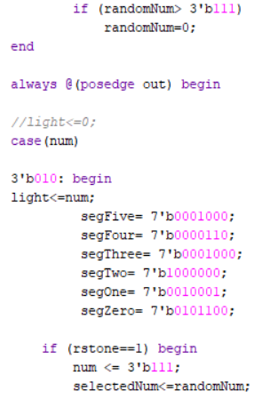
Main

Slide 9
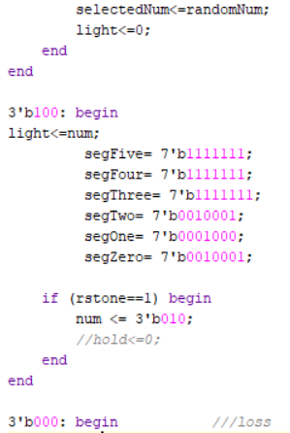
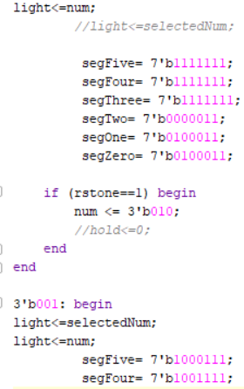
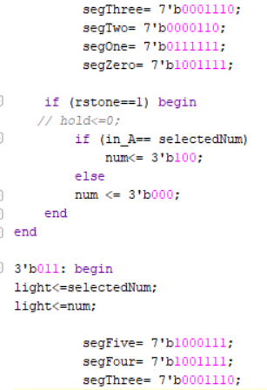
Main Cont.

Slide 10
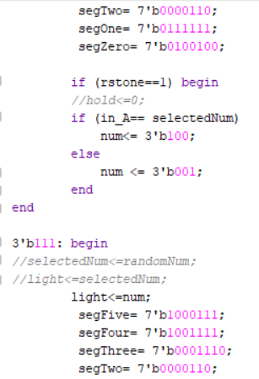
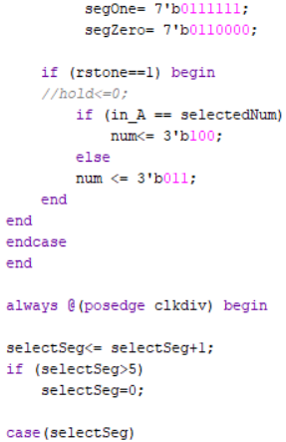
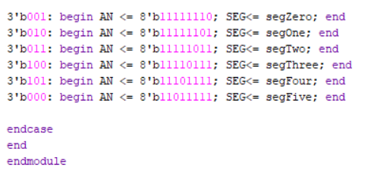
Main Cont.

Slide 11
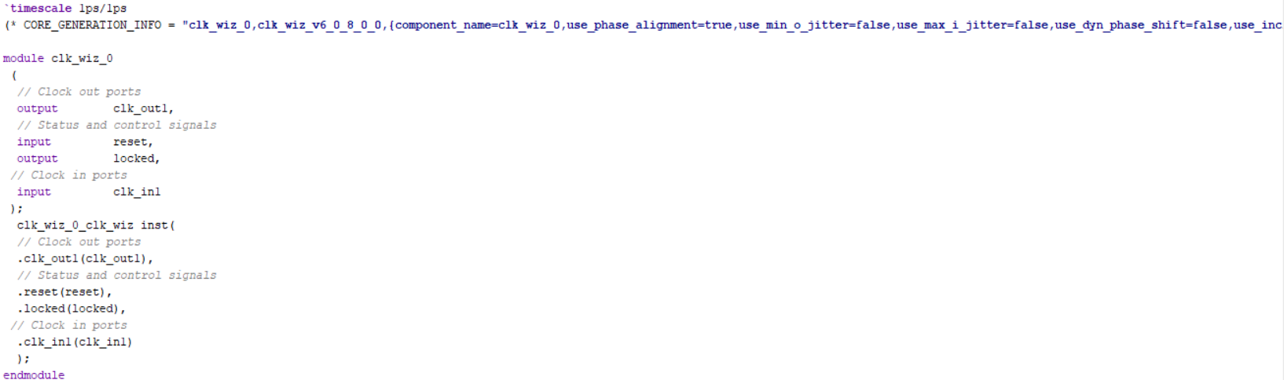
VGA Clock

Slide 12
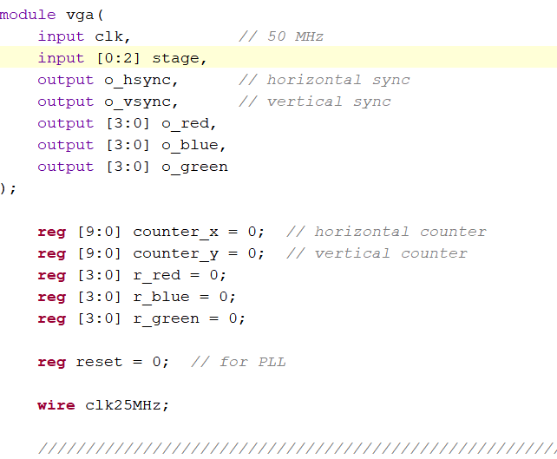
VGA

Slide 13
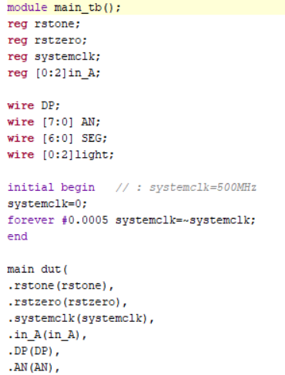
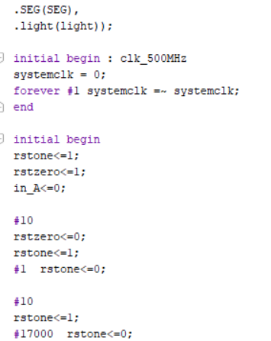
Main Test Bench

Slide 14
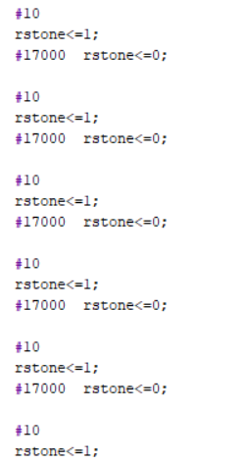
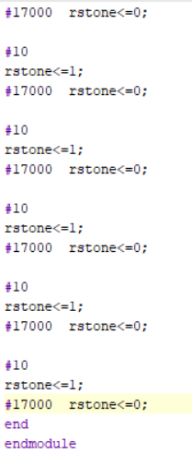
Main Test Bench

Slide 15
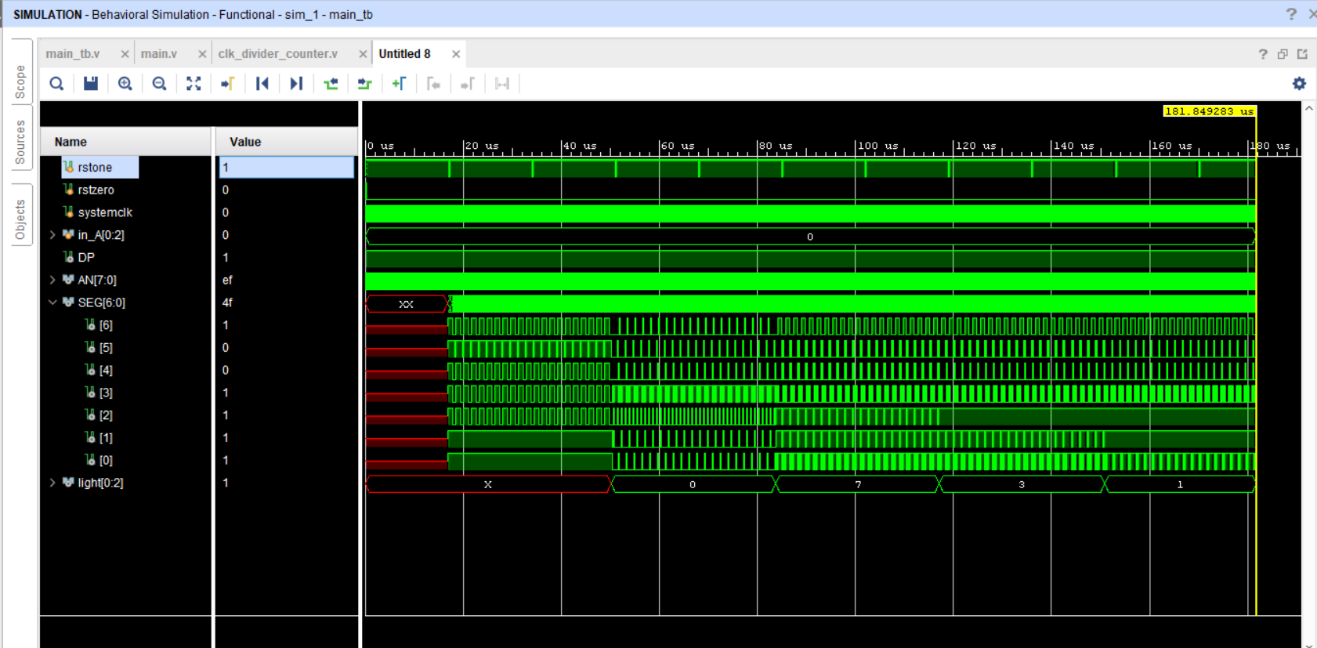
Main Test Bench Output

Slide 16
Meet our team
Clock Divide
Testbench
Counter
Main
Constraints
Github
5x31 Mux
Testbench
Main
Constraints
PowerPoint
VGA
Testbench
Main
Constraints
Testbenches
GitHub
Counter
Testbenches
Main
Constraints
PowerPoint
Sahiti Kattamedi
Neha Khan
Jorge Mejia
Jesse ortiz

Slide 17

Thank you

